Slide 1
GW Drupal 2022 Overview
Will begin soon

Slide 2
GW Drupal 2022 Overview

Slide 3
Agenda
What is Drupal?
Content Types
Web Accessibility
User Accounts
Walkthrough – Creating and Editing a Page

Slide 4
What is GW Drupal?
Drupal is a content management system (CMS)
GW’s official platform for academic and administrative websites
Customized for GW
Shared styles, features, and functionality
Compliant with GW standards
Notes:
“Out of the box”, Drupal is very basic.
It has no branding or styles of any kind.
Compliant
Design complies with GW guidelines for visual identity, data privacy, and accessibility
Customized
to meet GW user base needs

Slide 5
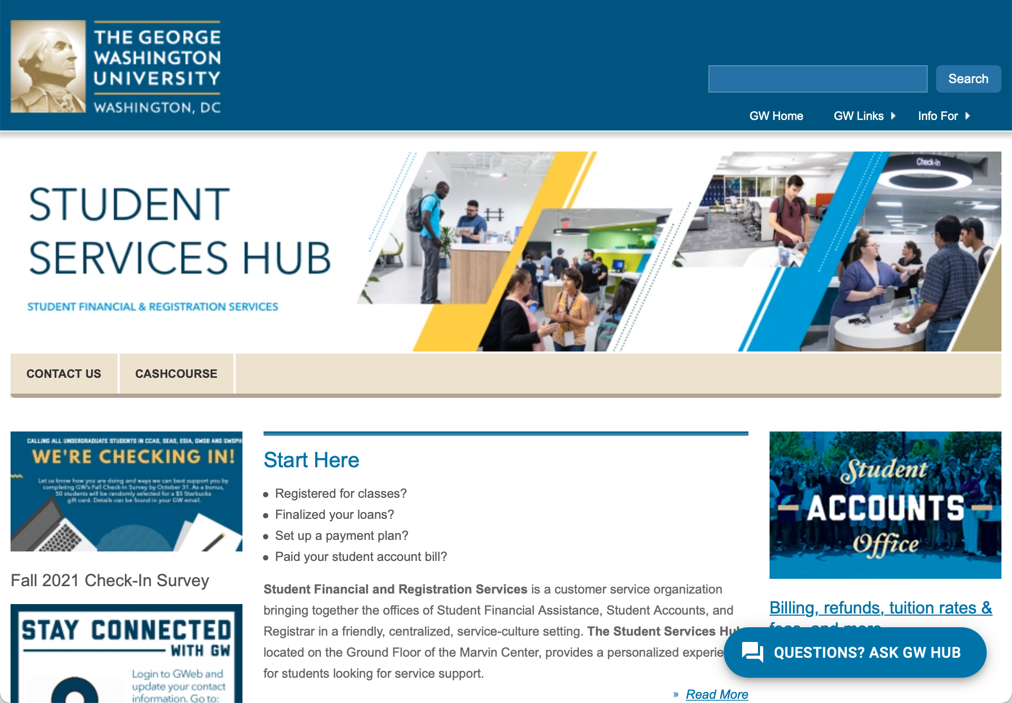
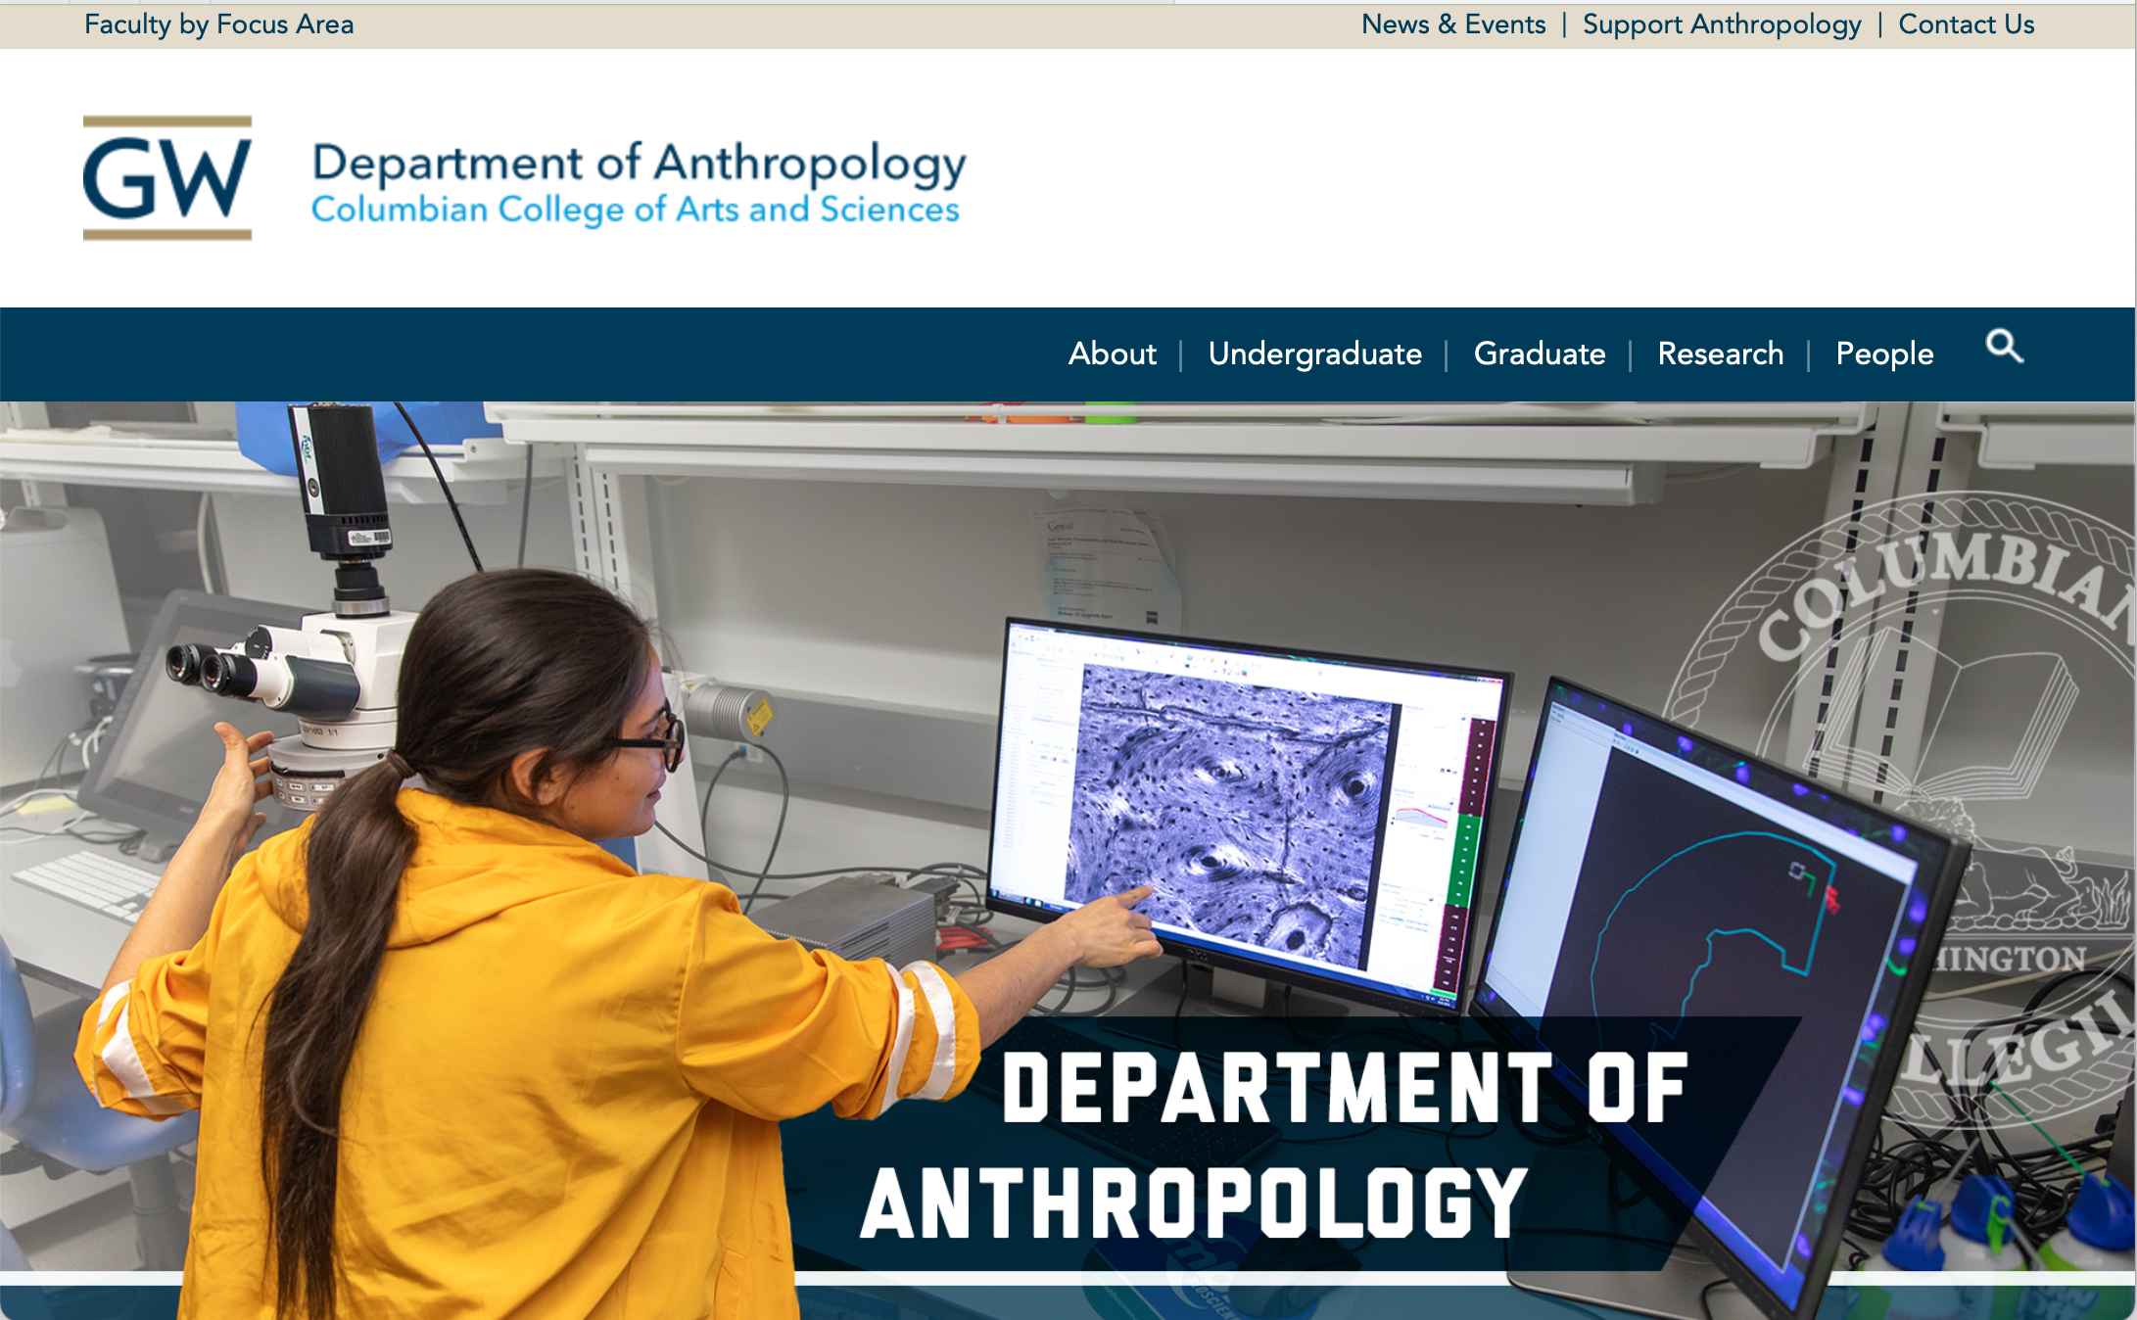
GW Drupal Themes
Classic
Editorial
2022
Notes:
“Out of the box”, Drupal is very basic.
It has no branding or styles of any kind.
Compliant
Design complies with GW guidelines for visual identity, data privacy, and accessibility
Customized
to meet GW user base needs

Slide 6
GW Drupal Content Types
Content Types are the building blocks of GW Drupal. They are structured templates used to present website content, and allow site owners to manage a website without coding or design expertise.
Be sure to use the correct Content Type to ensure pages and sidebars function as expected
In many cases, specific functionality is tied to specific Content Types
Notes:
Unintended impact
Example: an automatic feed of events requires using the Event content type

Slide 7
Common Content Types
Basic Page
Article
Event
Person
Webform
Advanced Page

Slide 8
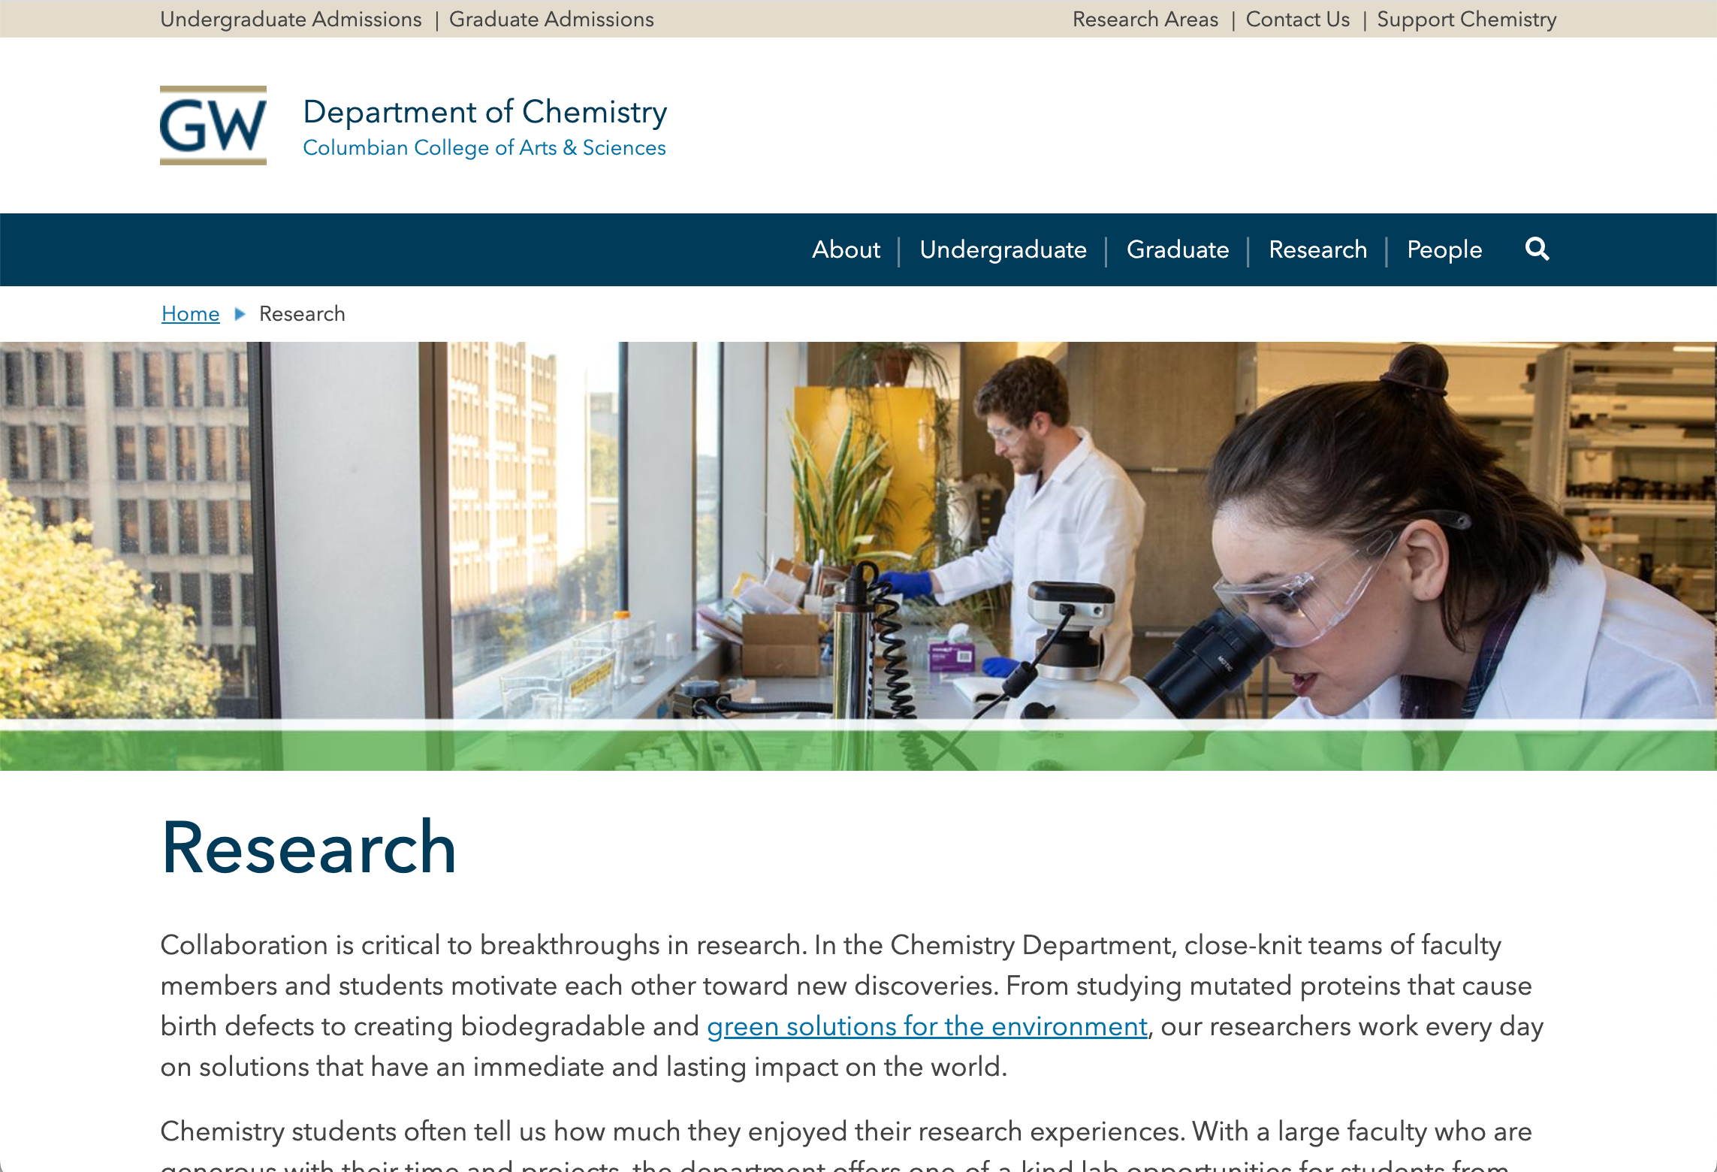
Basic Page
Basic page template
Works well as a landing page
Text and images expand across the full content width (approximately 1100px)
Notes:
Common uses:
About page
Mission Statement
Contact Us
etc...

Slide 9
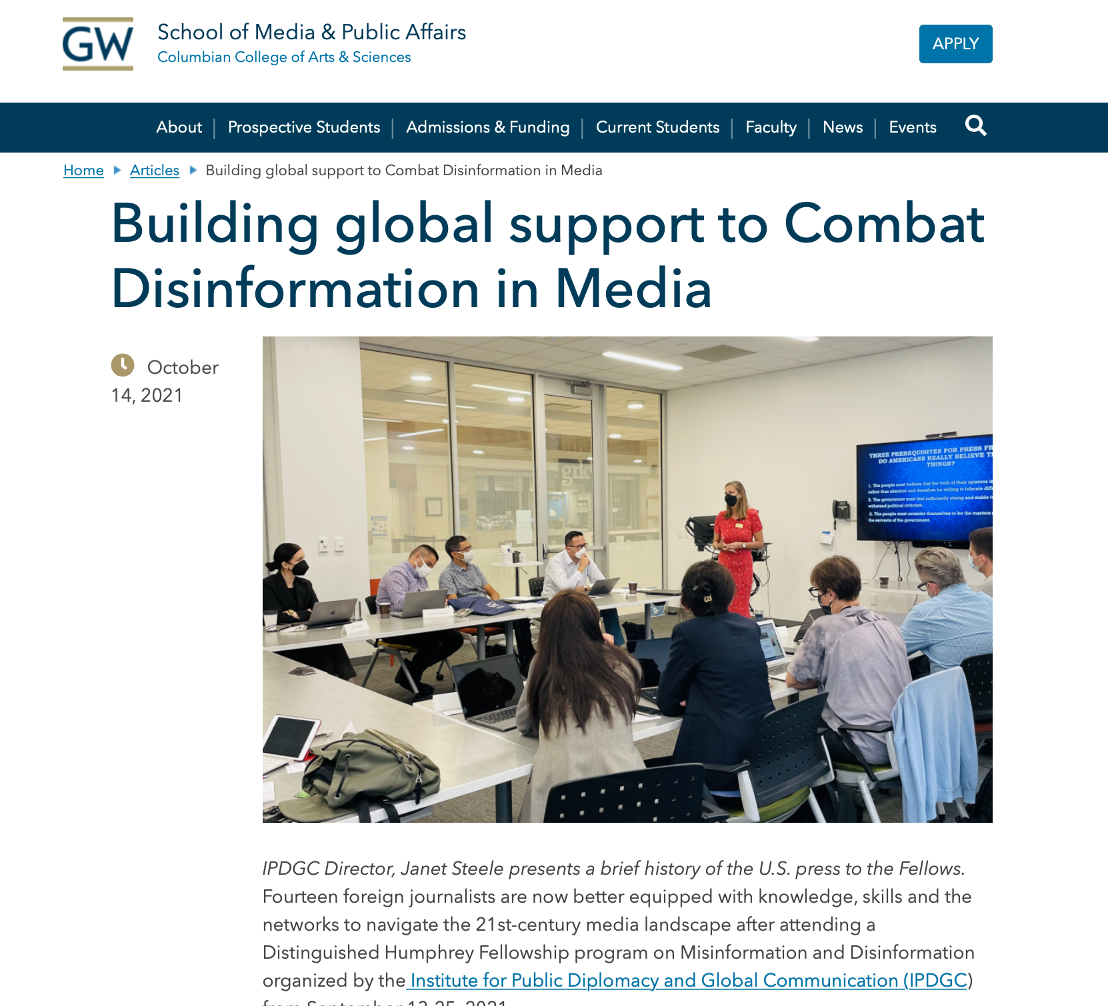
Article
Used for news content
Displays a publication date
Used to create an automatic News Feed or Article Archive
Chronological based on the publication date
If present, Featured Media will display above the Body text
Notes:
Distinguishing factor is that it's date-driven

Slide 10
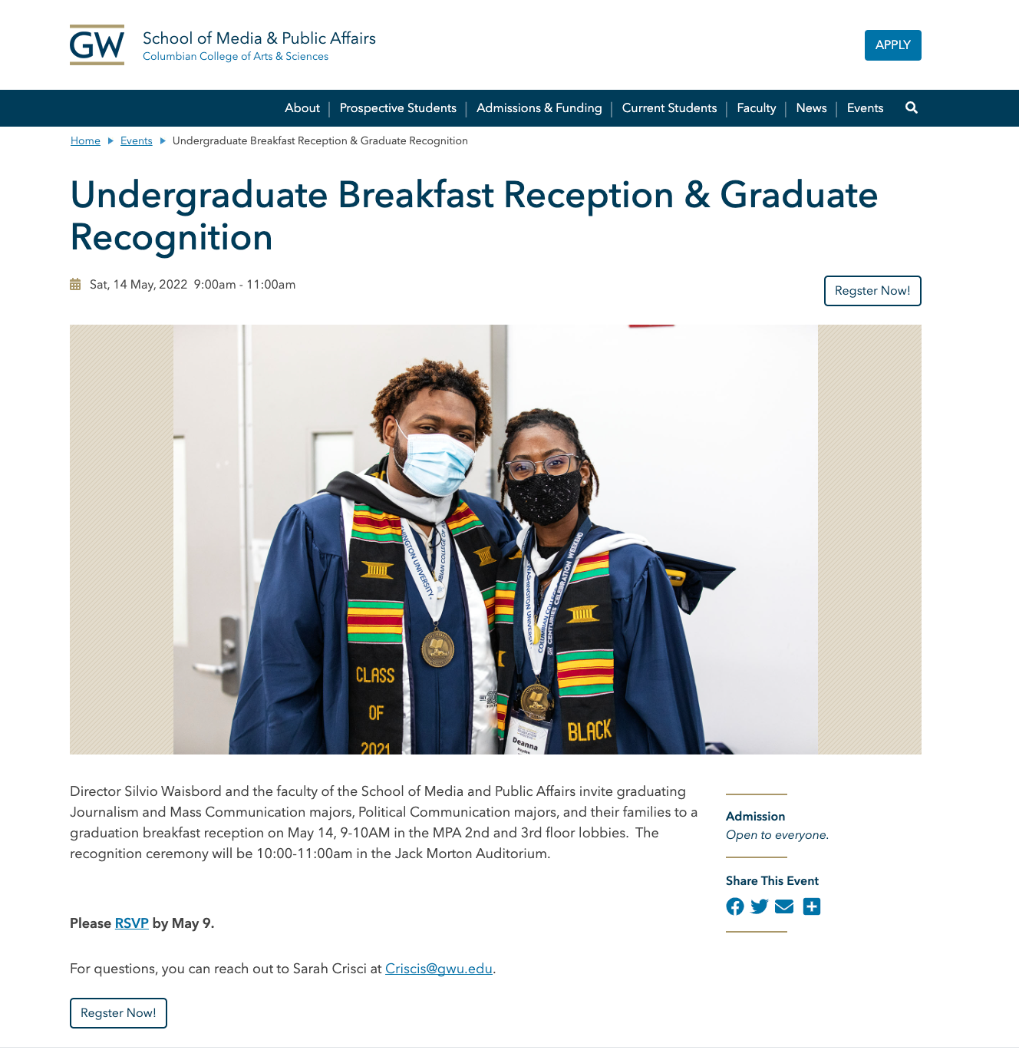
Event
Displays Event details such as Date, Location, and Contact info at the top and in a right sidebar
Also provides a customizable Call to Action button link
Used to create an Event Feed or Event Archive
Chronologically based on the event date
If present, the Featured Media will display above the Body text
Notes:
Like the Article CT, Event pages are date-driven

Slide 11
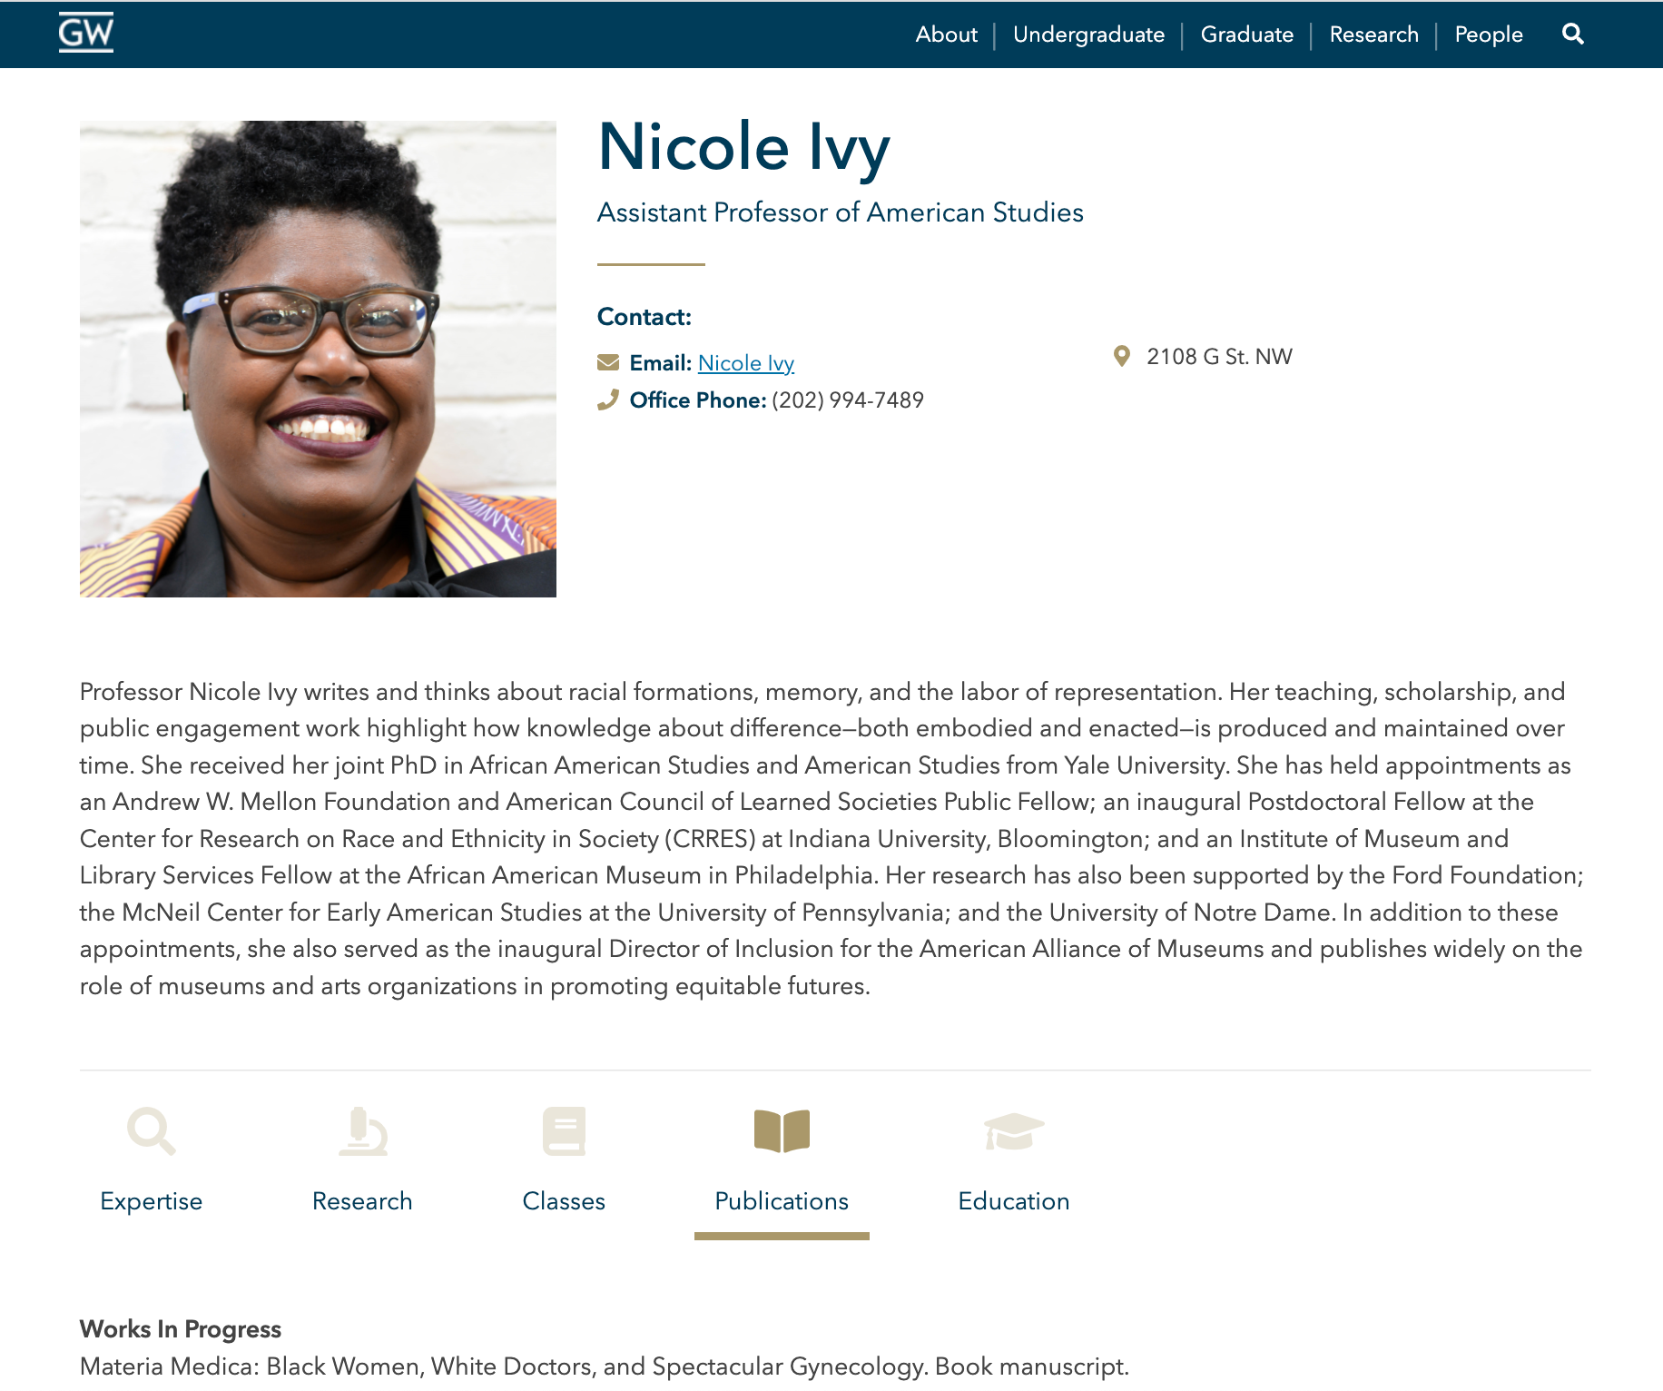
Person
Biography page for individuals
Provides multiple, optional text fields for as simple or robust a profile as necessary
Subheads over text areas customizable and optional
Can be used to automatically create an alphabetized directory of Person profiles

Slide 12
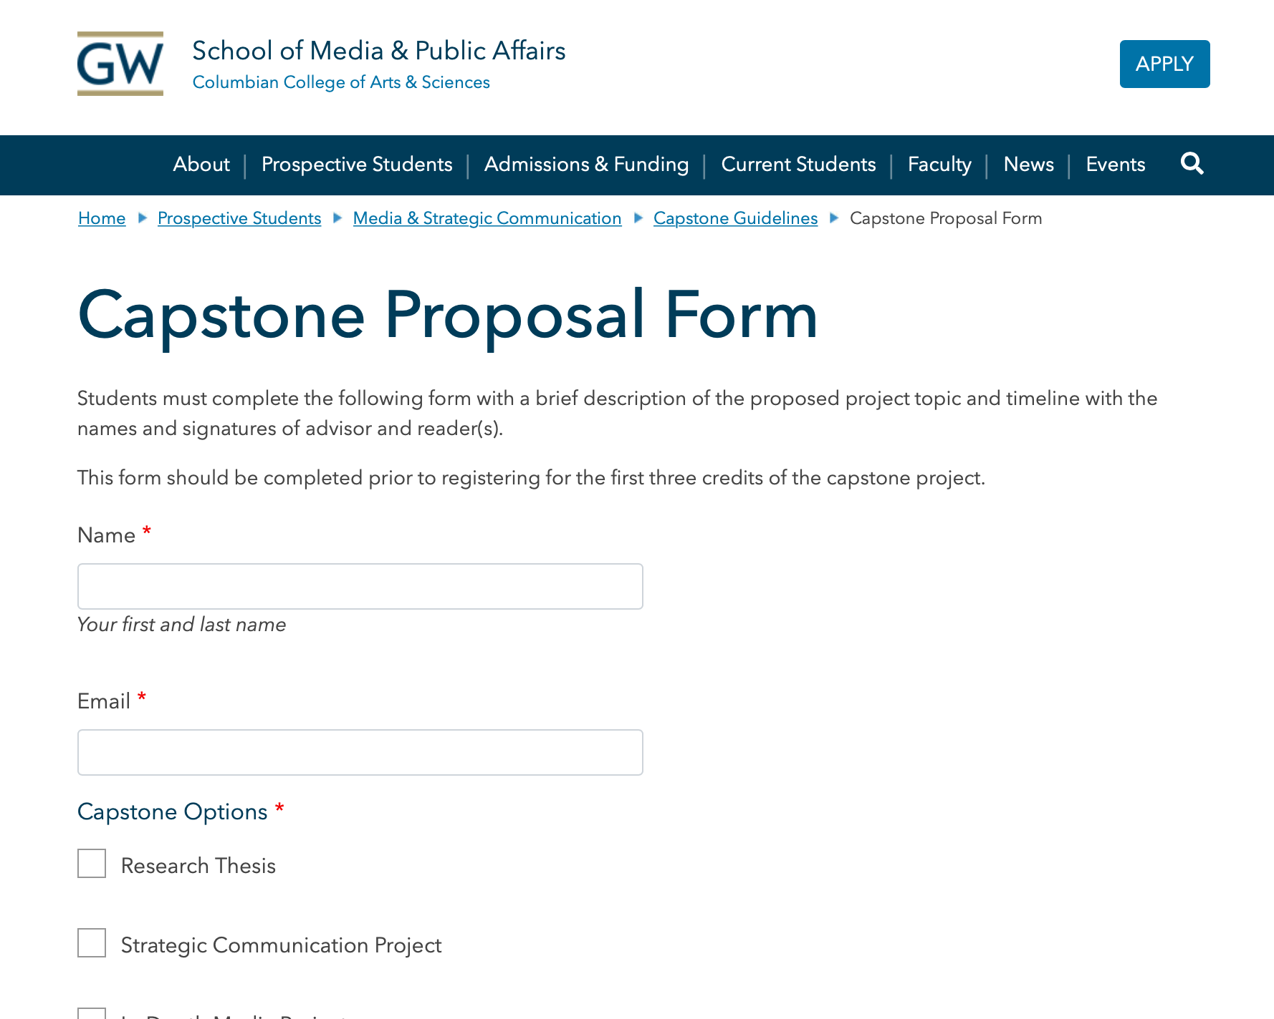
Webform
Creates a fillable form on your website
Submissions are logged in GW Drupal by default
Results can be exported as an Excel or CSV file
Requires backend access to the Drupal site
Emails can be set up to notify one or more people of submissions
Notes:
END of Detail Content types

Slide 13
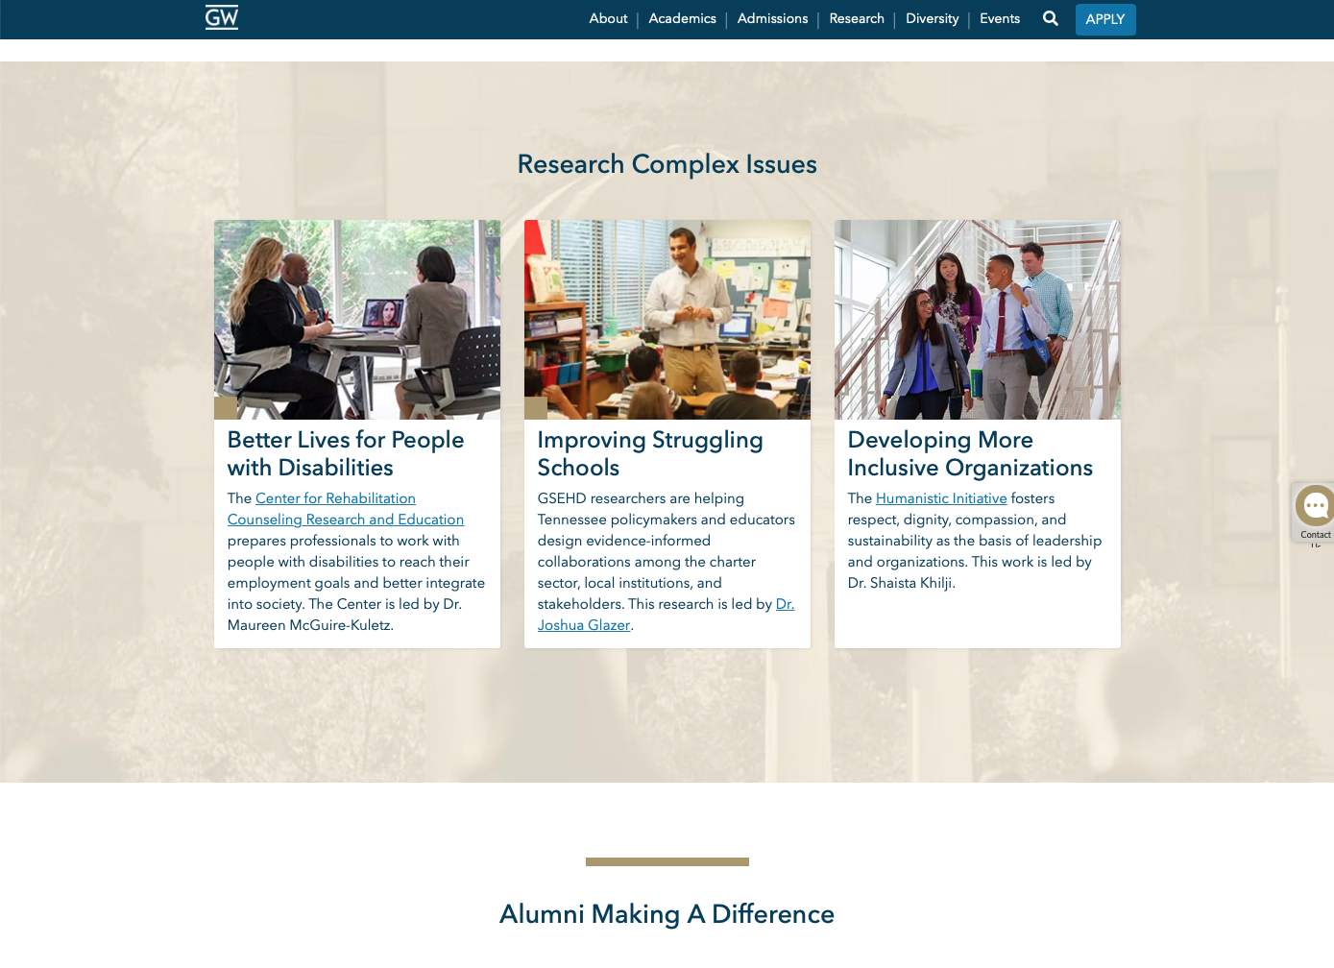
Advanced Page
Similar to Basic Pages but have additional features
They are often used for more complicated pages such as homepages
Only available for Site Owners
Allow you to add multiple page content sections
Notes:
Common uses:
About page
Mission Statement
Contact Us
etc...

Slide 14
Content Types: Inherited
Utility Links
Main Header
Footer
Notes:
Inherited content: create global elements that display via Site Placement
These elements are created once and then distributed site-wide
Usually require little to no maintenance, as they are meant to be evergreen in nature

Slide 15
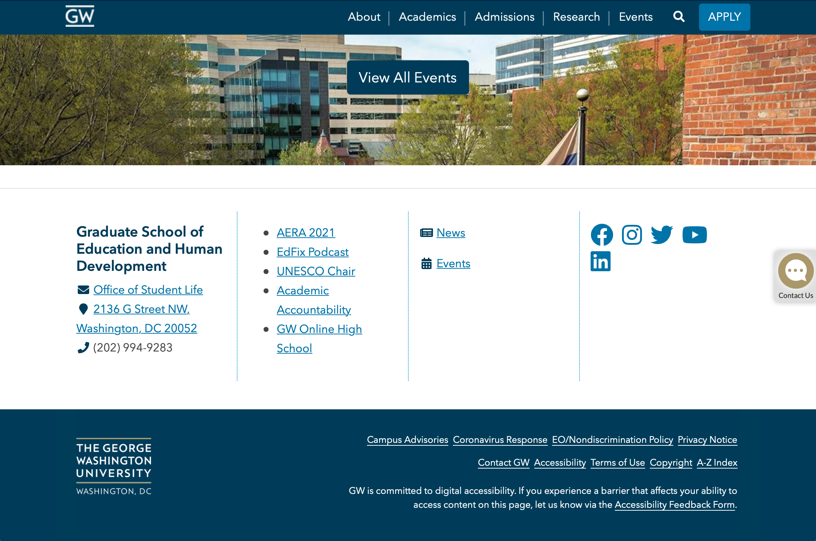
Inherited Elements
Utility Links
“Quick links” that display at the top of the browser screen
Main Header
Displays the site logo and an optional Call-to-Action button link
Footer
Each column is a free-form text area
Notes:
The hero banner has probably already been set up on your website.
If you need to update it, review our tutorial video on the Online Strategy.
Interior pages typically use a small.
You can also have a medium, but it requires manual configuration for each page.

Slide 16
Web Accessibility
Ensuring that your digital presence is accessible by all users, no matter their web browser or device
Websites display differently for people using assistive technology devices, such as a screen reader
Improves search engine optimization (SEO) & usability for all website visitors

Slide 17
Web Accessibility
Making websites accessible is a best practice
Also a legal requirement
Be sure to:
Use headings to identify topics on a page, not as decoration
Enter descriptive Alternative text (aka “alt” tags) on all images
Visit accessibility.gwu.edu for more information

Slide 18
GW Drupal User Accounts
 | Reviewer | Editor | Content Owner | Site Owner
View pages and drafts
Create and edit pages
Edit menu settings
Publish content
Use the Advanced Page
Manage additional site customization options
Edit the Header and Local Footer
Manage users

Slide 19
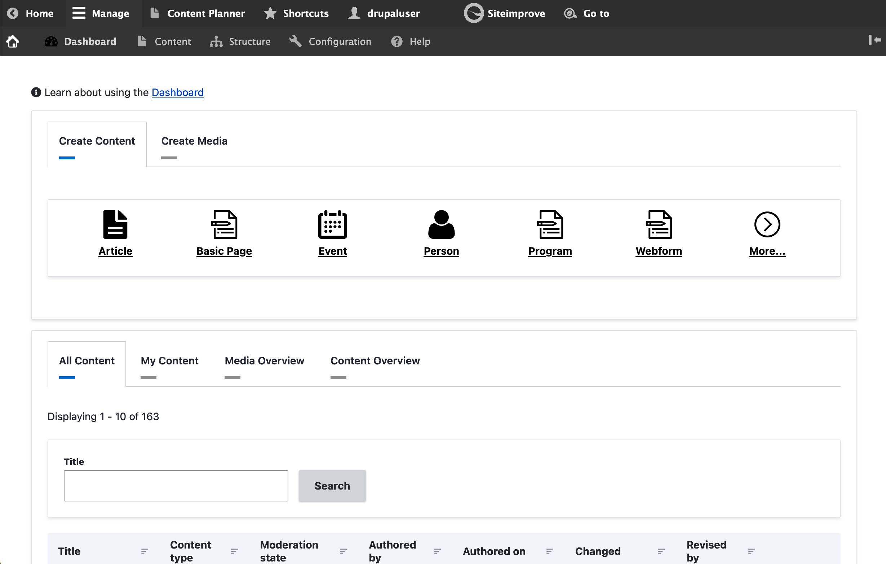
The Dashboard
Allows you to create new content or add media to the media library
Content tabs allow you to view all existing content and media
View any of our recent content updates
Notes:
° When you log in, you'll be presented with the dashboard and some tabs with additional functionality.

Slide 20
Walkthrough
Log into drupal2022training.drupal.gwu.edu/user
Username: Your GW UserID
Password: GW UserID password
VPN will be required if you are not on campus
Sample Text: go.gwu.edu/2022sampletext

Slide 21
Resources
Office Hours:
go.gwu.edu/officehours
Virtual office hours via Webex or Zoom
Drupal 2022 Demo Site: drupal2022demo.gwu.edu

